Slide 1
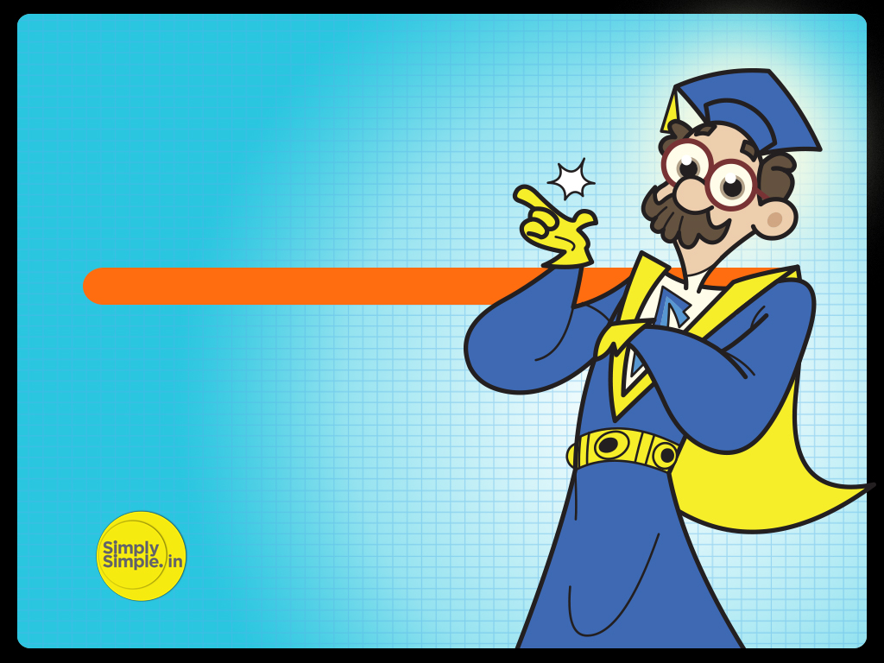
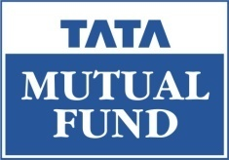
FED TAPERING
STAGFLATION

Slide 2

Understanding Stagflation – By Prof. Simply Simple

Slide 3

STAGFLATION
While we are perhaps overexposed to the term “inflation”, it would be interesting to understand the concept of stagflation in this context.
In the next few slides let me try and explain the same to you.

Slide 4
What is Stagflation?

Slide 5

STAGFLATION
While inflation refers to rising prices in a growing economy, stagflation takes place when price rises are accompanied by a stagnant economy.
Thus in stagflation:
- Prices of goods rise
- Economy does not exhibit growth
- Hence employment & consumption both dwindle
While inflation, which seems to be making all the news is bad; stagflation is a lot worse.

Slide 6
STAGFLATION
A balancing act
In this context, you will understand the role that the RBI Governor plays and the criticality of his role.
While the RBI, through its monetary policy aims to rein in inflation by increasing interest rates and CRR rates, it has to do a balancing act to ensure that the measures being enforced do not strangle economic growth and send the economy into stagflation.

Slide 7
STAGFLATION
While this may not be such a big problem for an economy like India which still has substantial growth potential in spite of inflation; for countries growing at 1% to 2%, the balancing act by the central bank gets extremely crucial to prevent the economy from slipping into stagflation.

Slide 8
STAGFLATION
This is why we describe the Indian economy as being robust, based on sound fundamentals of consumption potential which, in a sense, hedge the economy from the forces of stagflation.

Slide 9

STAGFLATION
What is the remedy for stagflation?

Slide 10
STAGFLATION
Removal of structural bottlenecks by introducing reforms would help unlock the economy’s growth potential.
Along with introducing reforms, tightening of monetary screws by the central bank can further stir the economy out of stagflation.

Slide 11
STAGFLATION
To Sum Up
Recession can be held at bay by lowering interest rates, while inflation is usually tamed by raising interest rates.
Given the impossibility of pursuing both courses of action simultaneously, priorities come into play. This is where the actions of the RBI become crucial.
Historically, inflation has been considered the greater long term economic menace and has therefore been dealt with first but taking care that the growth engine is not derailed leading to stagflation.
As our economic growth is based on strong fundamentals, we need not fear stagflation but need to overcome inflationary forces.

Slide 12
STAGFLATION
Hope you have now understoo the concept of Stagflation

Slide 13

In case of any query, please e-mail
lchaturvedi@tataamc.com

Slide 14

DISCLAIMER
The views expressed in this lesson are for information purposes only and do not construe to be any investment, legal or taxation advice. The lesson is a conceptual representation and may not include several nuances that are associated and vital. The purpose of this lesson is to clarify the basics of the concept so that readers at large can relate and thereby take more interest in the product / concept. In a nutshell, Professor Simply Simple lessons should be seen from the perspective of it being a primer on financial concepts. The contents are topical in nature and held true at the time of creation of the lesson. This is not indicative of future market trends, nor is Tata Asset Management Ltd. attempting to predict the same. Reprinting any part of this material will be at your own risk. Tata Asset Management Ltd. will not be liable for the consequences of such action.
Mutual Fund investments are subject to market risks, read all scheme related documents carefully.

